Slide 1
SOFTWARE REENGINEERING
1
Notes:
1

Slide 2
Lecture Summary
To explain why software re-engineering is a cost-effective option for system evolution
To describe the activities involved in the software re-engineering process
To distinguish between software and data re-engineering and to explain the problems of data re-engineering
To Distinguish between Business process reengineering and software reengineering process
2
Notes:
2

Slide 3
Topics covered
Source code translation
Reverse engineering
Program structure improvement
Program modularisation
Data re-engineering

Slide 4
Software re-engineering
Reorganising and modifying existing software systems to make them more maintainable
"the examination of a subject system to reconstitute it in a new form and the subsequent implementation of the new form.

Slide 5
System re-engineering
Re-structuring or re-writing part or all of a legacy system without changing its functionality
Applicable where some parts, but not all sub-systems, of a larger system require frequent maintenance
Re-engineering involves adding effort to make them easier to maintain. The system may be re-structured and re-documented

Slide 6
When to re-engineer
When system changes are mostly limited to part of the system then re-engineer that part
When hardware or software support becomes outdated
When new ways of accessing are needed, but its functionality remains there.
When tool support is not available

Slide 7
Re-engineering advantages
Reduced risk
There is a high risk in new software development. There may be development problems, staffing problems and specification problems
Reduced cost
The cost of re-engineering is often significantly less than the costs of developing new software

Slide 8
Business process
A business process is a series of steps performed by a group of stakeholders to achieve a concrete goal
A business process is a collection of linked tasks that find their end in the delivery of a service or product to a client.
A business process has also been defined as a set of activities and tasks that, once completed, will accomplish an organizational goal.

Slide 9
Business process re-engineering
Concerned with re-designing business processes to make them more responsive and more efficient
Often dependent on the introduction of new software or systems to support the revised processes
May force software re-engineering as the legacy systems are designed to support existing processes

Slide 10
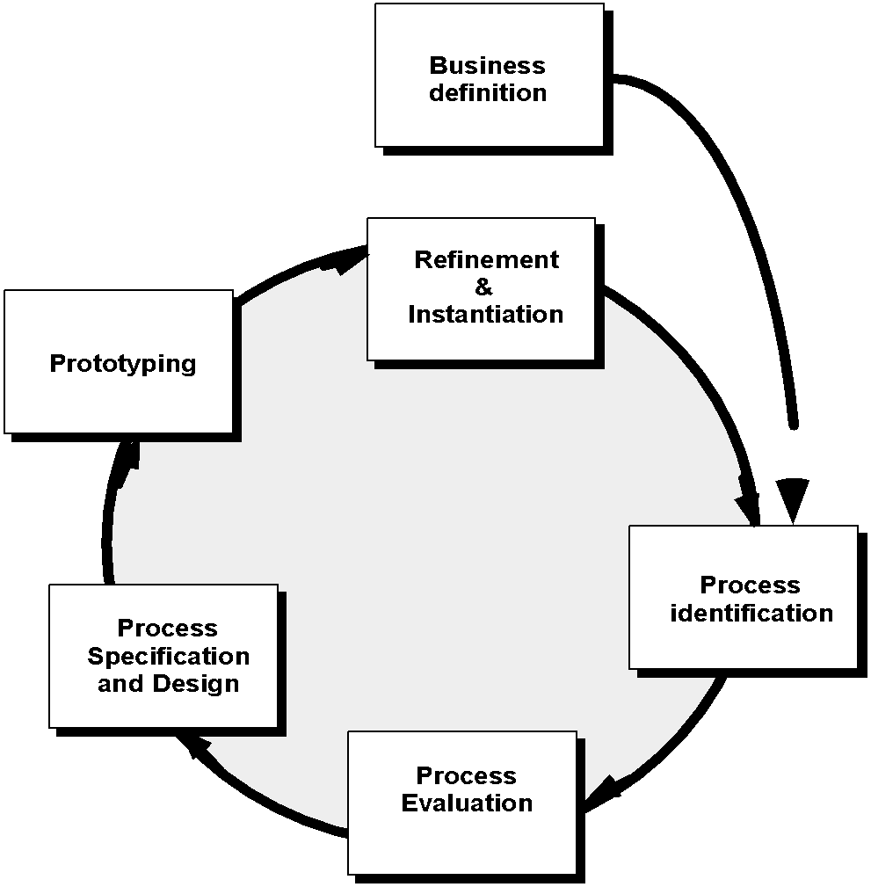
Business Process Reengineering
10

Slide 11
Business Process Reengineering
Business definition. Business goals are identified within the context of four key points:
cost reduction,
time reduction,
quality improvement,
personnel development
11

Slide 12
Business Process Reengineering
Process identification. Processes that are critical (dangerous) to achieving the goals (defined in the business definition) are identified.
Process evaluation. The existing process is thoroughly analyzed and measured.
12

Slide 13
Business Process Reengineering
Process specification and design. Based on information obtained during the first three BPR activities,
use-cases are prepared for each process that is to be redesigned.
13

Slide 14
Business Process Reengineering
Prototyping. A redesigned business process must be prototyped before it is fully integrated into the business.
Refinement and representation. Based on feedback from the prototype, the business process is refined and then represented with in a business system.
14

Slide 15
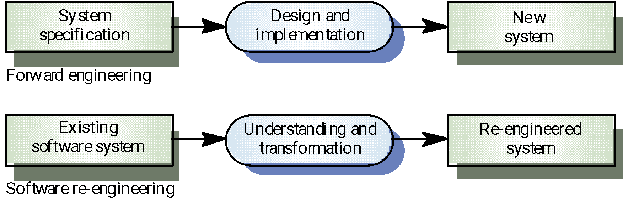
Forward engineering and re-engineering

Slide 16
Re-Engineering Process
Source code translation
Reverse engineering
Program structure improvement
Program modularisation
Data re-engineering

Slide 17
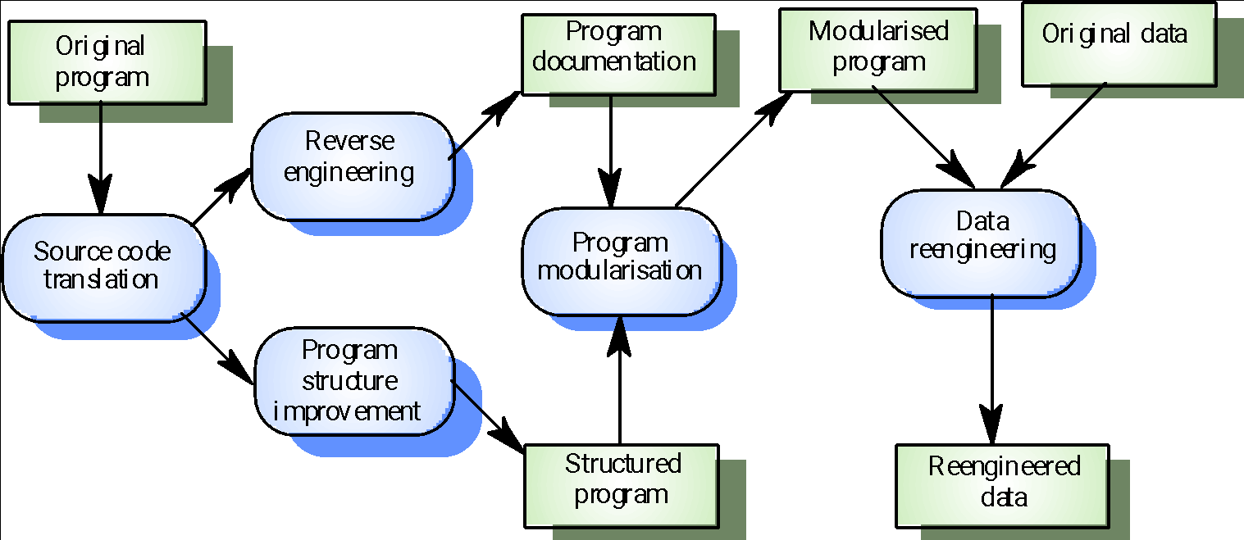
The re-engineering process

Slide 18
Re-engineering cost factors
The quality of the software to be re-engineered
The tool support available for re-engineering
The extent of the data conversion which is required
The availability of expert staff for re-engineering

Slide 19
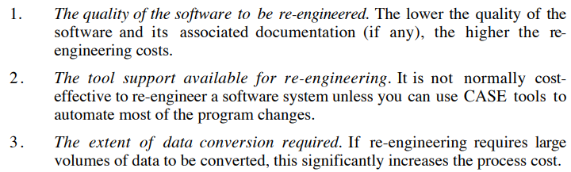
Re-engineering cost factors

Slide 20
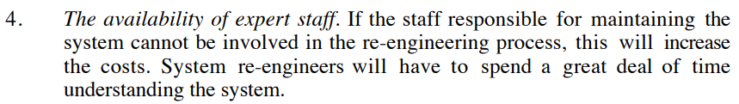
Re-engineering cost factors

Slide 21
Re-engineering cost factors
Computer aided software engineering (CASE) is the implementation of computer facilitated tools and methods in software development.
CASE is used to ensure a high-quality and defect-free software.
CASE ensures a check-pointed and disciplined approach and helps designers, developers, testers, managers and others to see the project milestones during development.

Slide 22
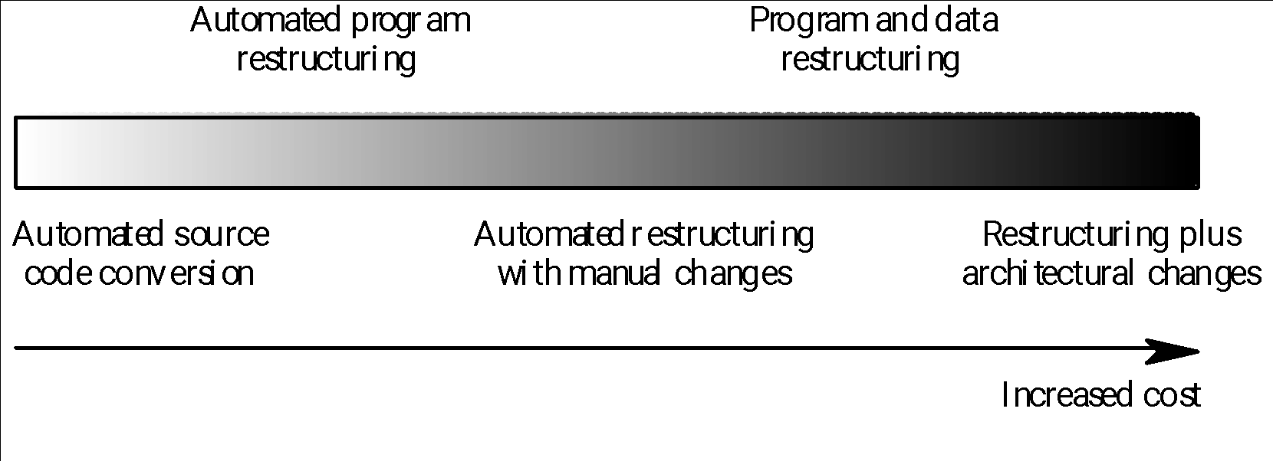
Re-engineering approaches

Slide 23
Re-Engineering Process
Source code translation
Reverse engineering
Program structure improvement
Program modularisation
Data re-engineering

Slide 24
1.Source Code Translation
Involves converting the code from one language (or language version) to another e.g. FORTRAN to C
May be necessary because of:
Hardware platform update
Staff skill shortages
Organisational policy changes
Only realistic if an automatic translator is available

Slide 25
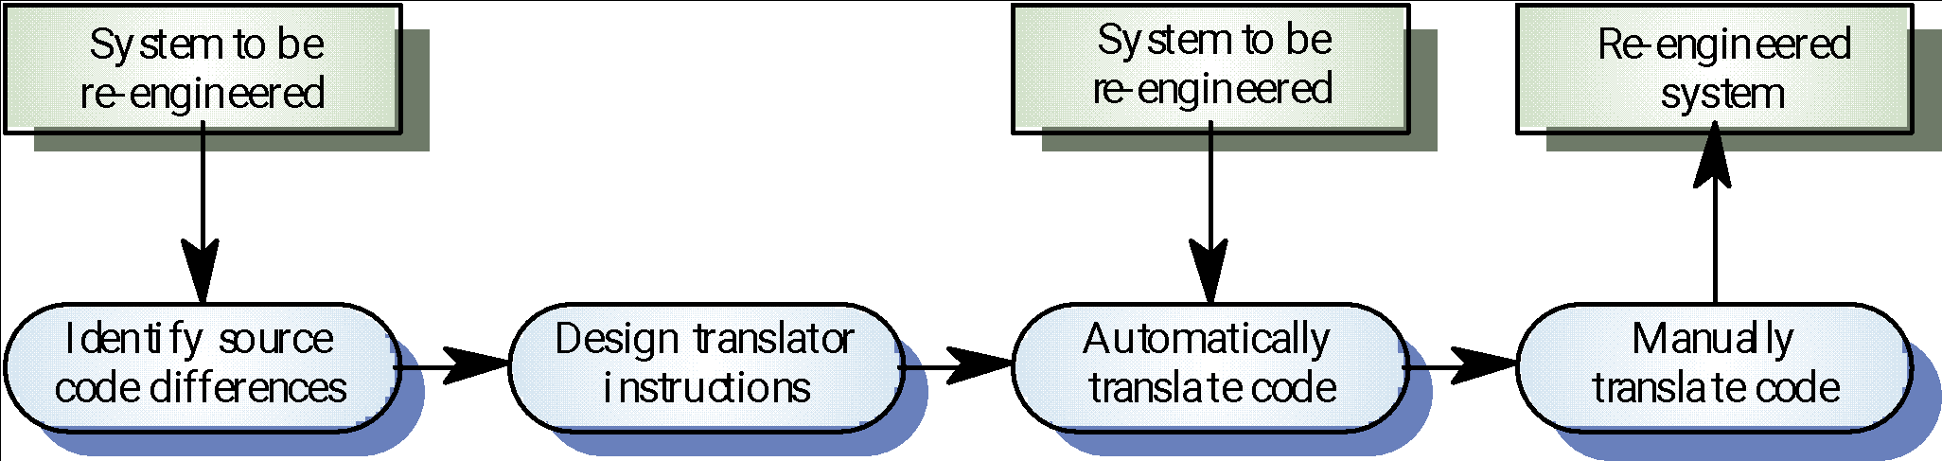
The program translation process

Slide 26
Re-Engineering Process
Source code translation
Reverse engineering
Program structure improvement
Program modularisation
Data re-engineering

Slide 27
2. Reverse engineering
Analysing software with a view to understanding its design and specification
Part of a re-engineering process and may also be used to re-specify a system for re-implementation
Builds a program database and generates information from this

Slide 28
Reverse engineering
“Reverse engineering is the process of analyzing a subject system with two goals in mind:
(1) to identify the system's components and their interrelationships,
(2) to create representations of the system in another form or at a higher level of abstraction."

Slide 29
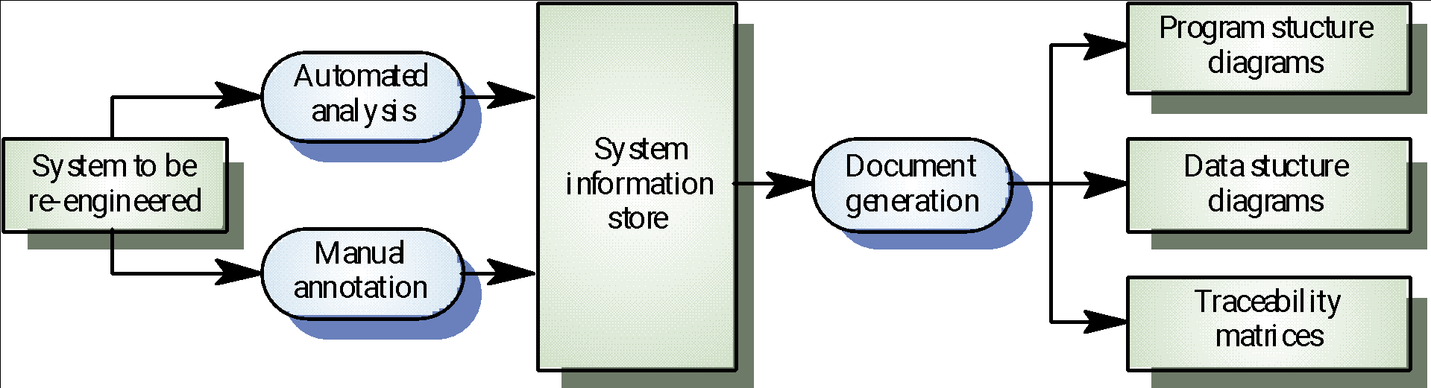
The reverse engineering process

Slide 30
Reverse engineering
“Design recovery is a subset of reverse engineering in which domain knowledge, external information, and fuzzy reasoning are added to the observations of the subject system."
The objective of design recovery is to identify meaningful higher-level abstractions beyond those obtained directly by examining the system itself.

Slide 31
Reverse engineering
Reverse engineering often leads re-engineering:
The design and specification of a system may be reverse engineered so that they can be an input to the requirements specification process for the system’s replacement
The design and specification may be reverse engineered to support program maintenance and reengineering

Slide 32
Re-Engineering Process
Source code translation
Reverse engineering
Program structure improvement
Program modularisation
Data re-engineering

Slide 33
3. Program structure improvement
Maintenance tends to corrupt the structure of a program. It becomes harder and harder to understand
The program may be automatically restructured to remove unconditional branches
Conditions may be simplified to make them more readable

Slide 34
Program structure improvement
Program Re-structuring
Condition Simplification
Automatic Program Re-structuring
Re-structuring Problems

Slide 35
Program Restructuring
“Restructuring is a transformation from one form of representation to another at the same relative level of abstraction."
The new representation is meant to preserve the semantics and external behaviour of the original.

Slide 36
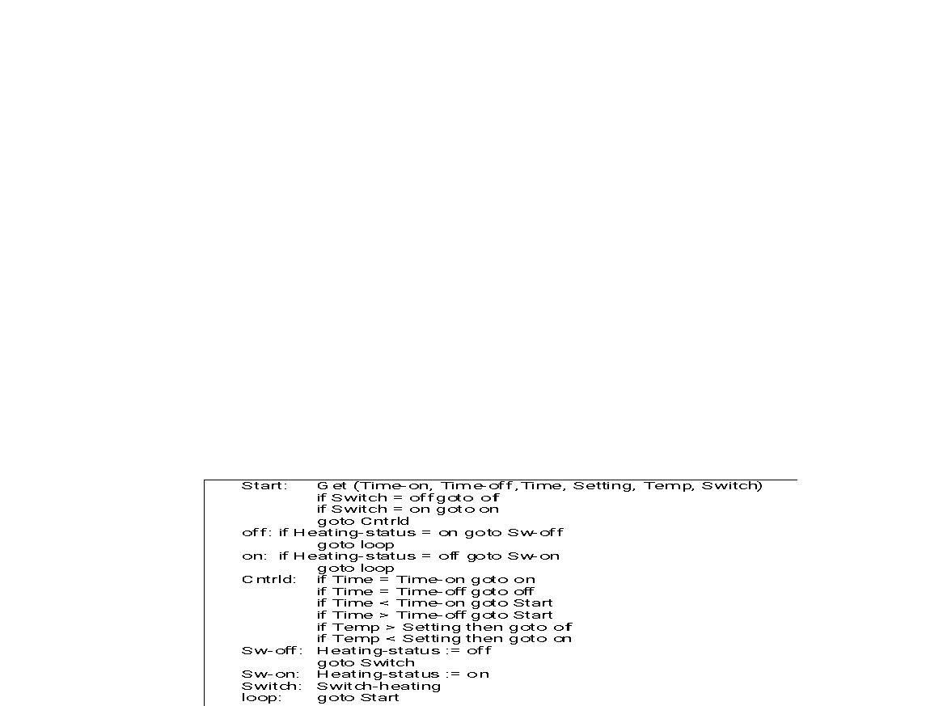
Spaghetti logic

Slide 37
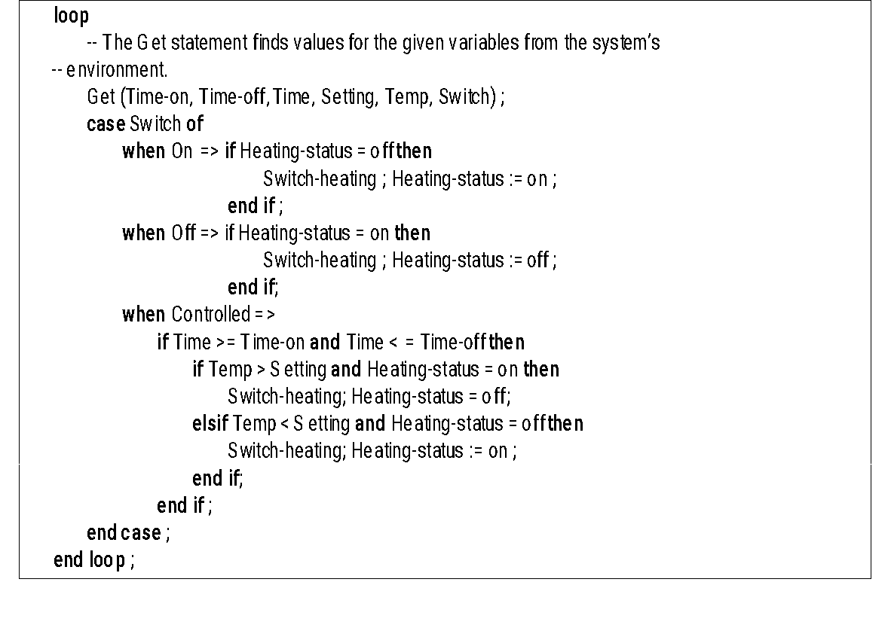
Structured control logic

Slide 38
Another Spaghetti logic
START:
GOTO MAMMALS
DOG:
WALK THE DOG
GOTO CAT
MAMMALS:
GOTO DOG
FISH:
FEED THE FISH
COVER THE BIRD
GOTO FROG
CAT:
PUT OUT THE CAT
GOTO FISH-AND-FOWL
FISH-AND-FOWL:
GOTO FISH
FROG:
SING TO THE FROG
EXIT.

Slide 39
Another structured control logic
START:
CALL FUNCTION DOG
CALL FUNCTION CAT
CALL FUNCTION FISH
CALL FUNCTION BIRD
CALL FUNCTION FROG
EXIT.
DOG:
WALK THE DOG
RETURN
CAT:
PUT OUT THE CAT
RETURN
FISH:
FEED THE FISH
RETURN
BIRD:
COVER BIRD CAGE
RETURN
FROG:
SING TO THE FROG
RETURN

Slide 40
Condition simplification
-- Complex condition
if not (A > B and (C < D or not ( E > F) ) )...
-- Simplified condition
if (A <= B and (C>= D or E > F)...

Slide 41
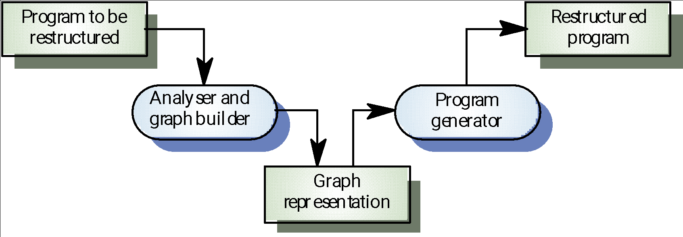
Automatic program restructuring

Slide 42
Code Analyzer
A code analyzer is a type of software testing application that reviews, analyzes and reports on the source code structure of a program or software.
It is used by software testers and quality assurance professionals to evaluate a program under a number of different software coding/programming regulations.

Slide 43
Restructuring problems
Problems with re-structuring are:
Loss of comments
Loss of documentation
Heavy computational demands
Restructuring doesn’t help with poor modularisation where related components are scattered throughout the code
The understandability of data-driven programs may not be improved by re-structuring

Slide 44
Restructuring problems
Data driven programming is a programming model where the data itself controls the flow of the program and not the program logic.
Data-driven development is a software engineering approach that relies on data to guide the development process.

Slide 45
Re-Engineering Process
Source code translation
Reverse engineering
Program structure improvement
Program modularisation
Data re-engineering

Slide 46
4. Program modularisation
The process of re-organising a program so that related program parts are collected together in a single module
Usually a manual process that is carried out by program inspection and re-organisation

Slide 47
Re-Engineering Process
Source code translation
Reverse engineering
Program structure improvement
Program modularisation
Data re-engineering

Slide 48
5. Data re-engineering
Involves analysing and reorganising the data structures (and sometimes the data values) in a program
May be part of the process of migrating from a file-based system to a DBMS-based system or changing from one DBMS to another
Objective is to create a managed data environment

Slide 49
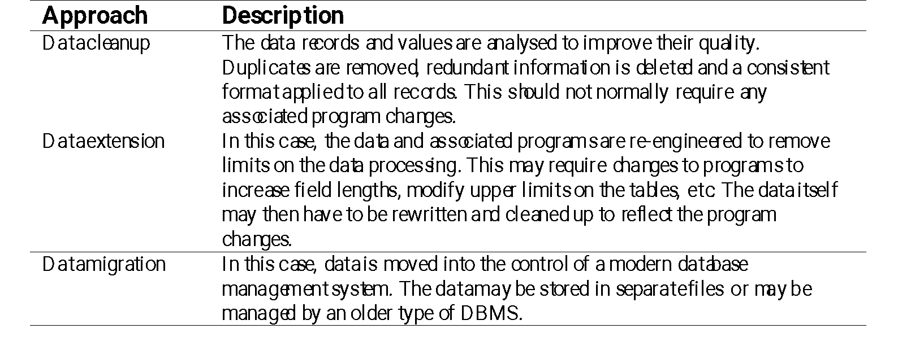
Approaches to data re-engineering

Slide 50
Data problems
Systems may have to process much more data than was originally intended by their designers
Redundant data may be stored in different formats in different places in the system

Slide 51
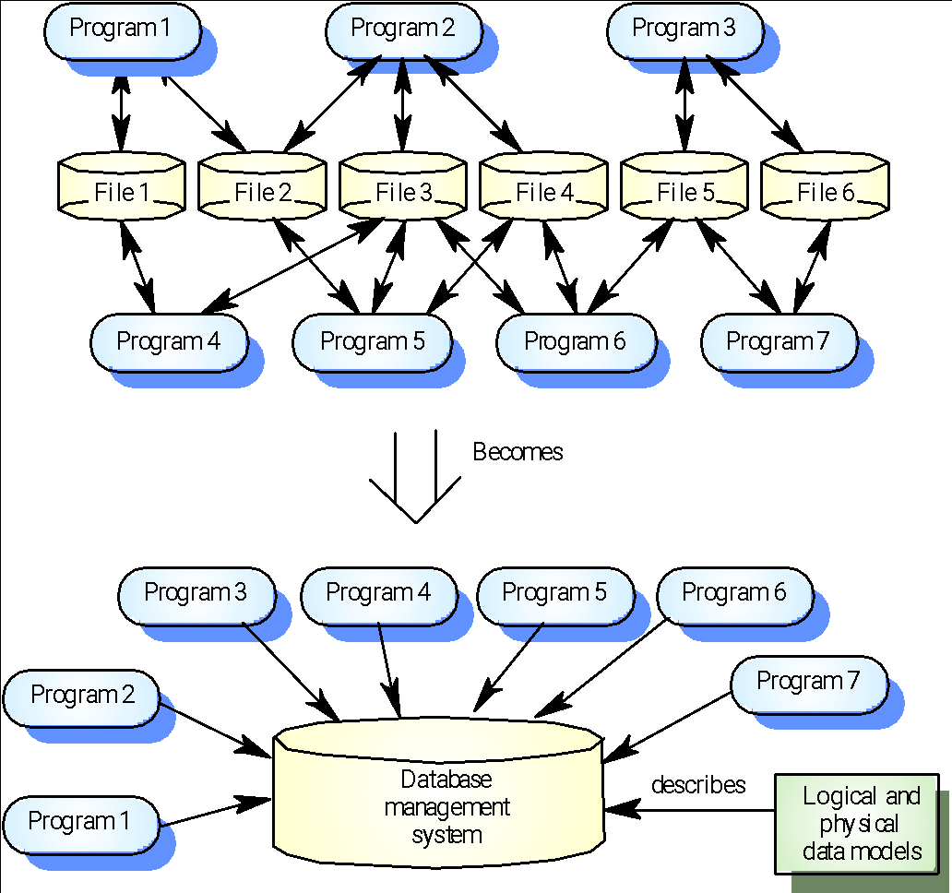
Data migration

Slide 52
Data problems
Data naming problems
Names may be hard to understand. The same data may have different names in different programs
Field length problems
The same item may be assigned different lengths in different programs
Record organisation problems
Records representing the same entity may be organised differently in different programs
No data dictionary

Slide 53
Data conversion
Data re-engineering may involve changing the data structure organisation without changing the data values
Data value conversion is very expensive. Special-purpose programs have to be written to carry out the conversion

Slide 54
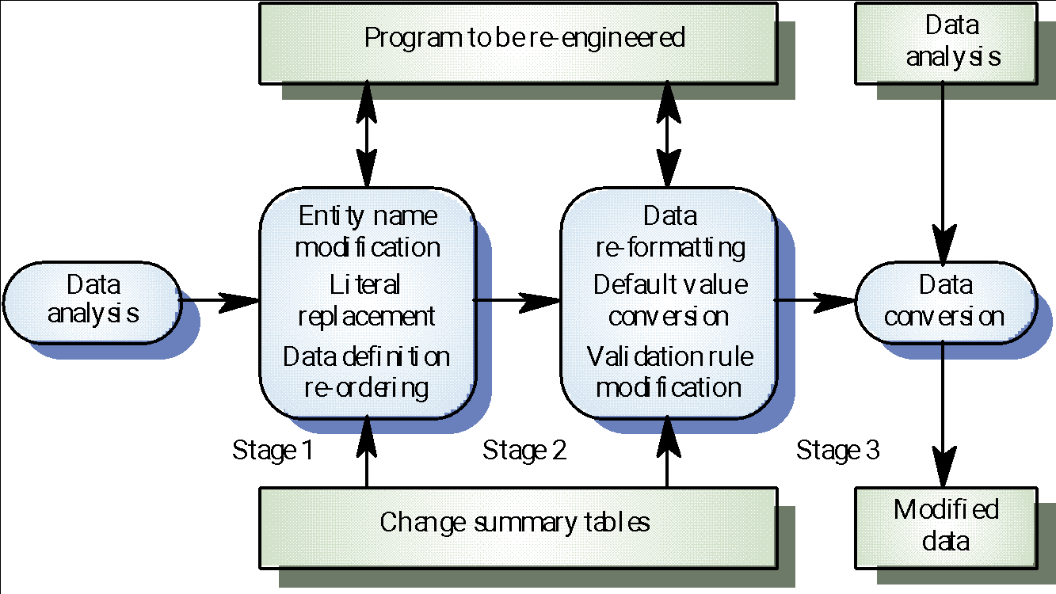
The data re-engineering process

Slide 55
Key points
The objective of re-engineering is to improve the system structure to make it easier to understand and maintain
The re-engineering process involves source code translation, reverse engineering, program structure improvement, program modularisation and data re-engineering
Source code translation is the automatic conversion of of program in one language to another

Slide 56
Key points
Reverse engineering is the process of deriving the system design and specification from its source code
Program structure improvement replaces unstructured control constructs with while loops and simple conditionals
Program modularisation involves reorganisation to group related items
Data re-engineering may be necessary because of inconsistent data management

